Slide 1
=====================
KNN-Based Image Search with Elasticsearch
Leveraging vector embeddings for efficient image similarity search
NAVIN BALAJI RK

Slide 2
Introduction
Problem: Searching for similar images is complex using traditional methods.
Goal: Use image embeddings + KNN to search similar images efficiently.
Tools: Javascript, CLIP, Elasticsearch, KNN vector search

Slide 3
What is Vector ?

Slide 4
Vector embeddings are a way to convert words and sentences and other data like images into numbers
that capture their meaning and relationship

Slide 5
Different type of Vectors
Dense Vector
Sparse Vector

Slide 6
What is KNN?

Slide 7
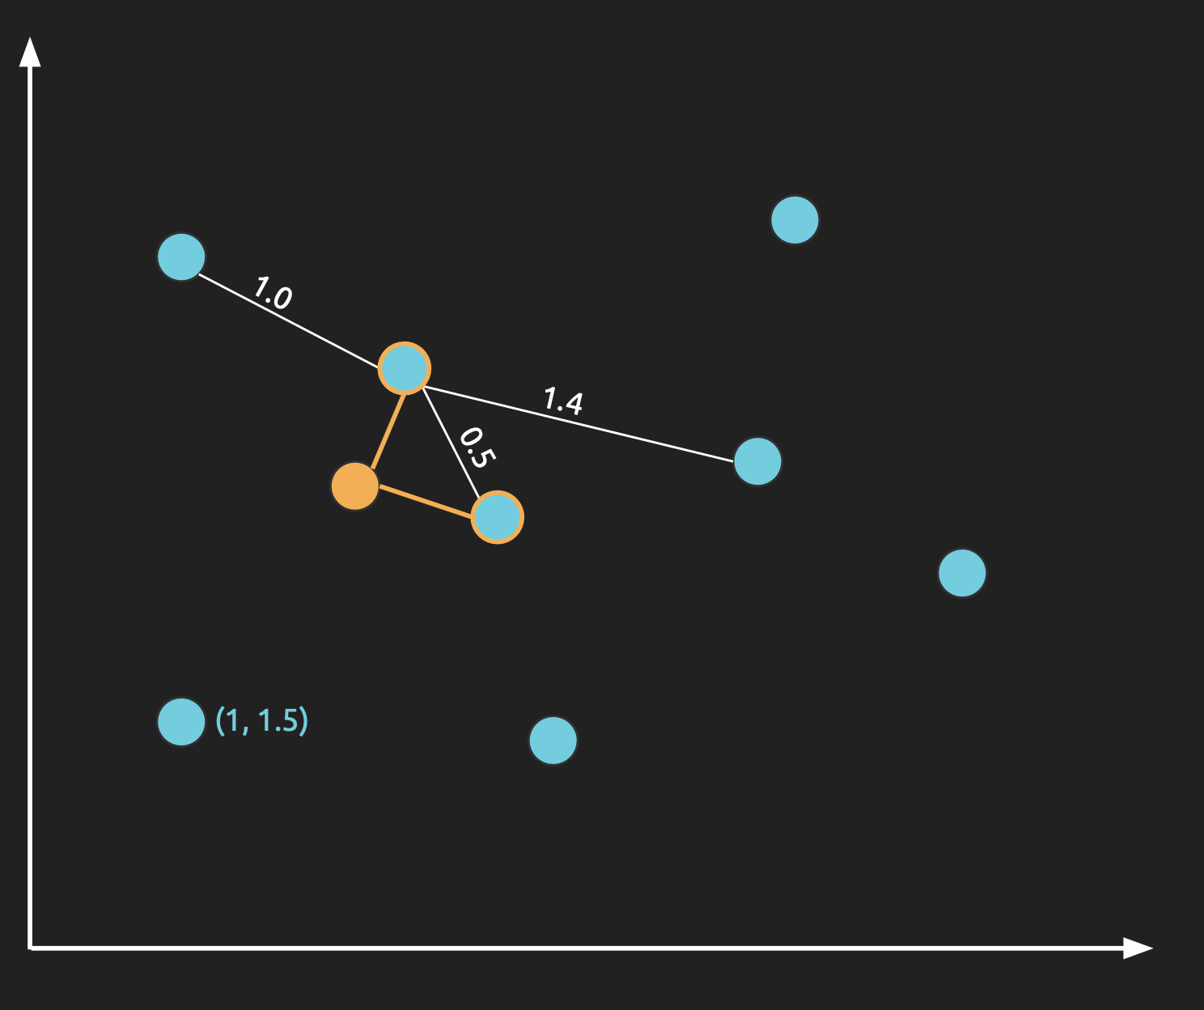

Slide 8
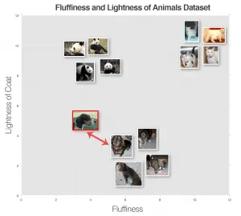

Slide 9
Image Vectorization
Use pre-trained models like OpenAI CLIP or Xenova/clip-vit-base-patch32
Convert images to 512-D

Slide 10
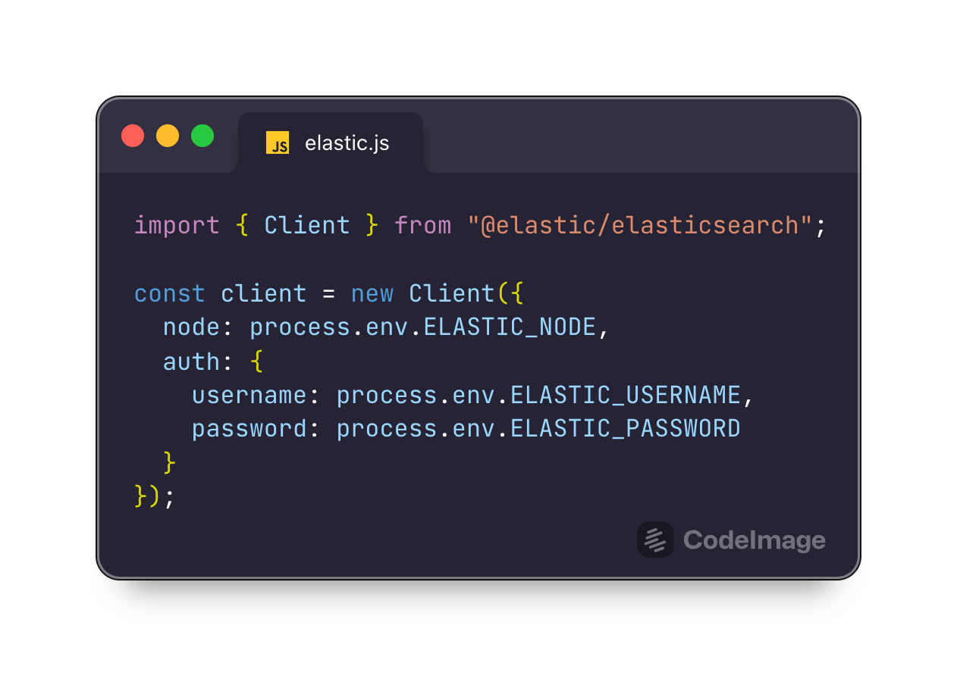

Slide 11
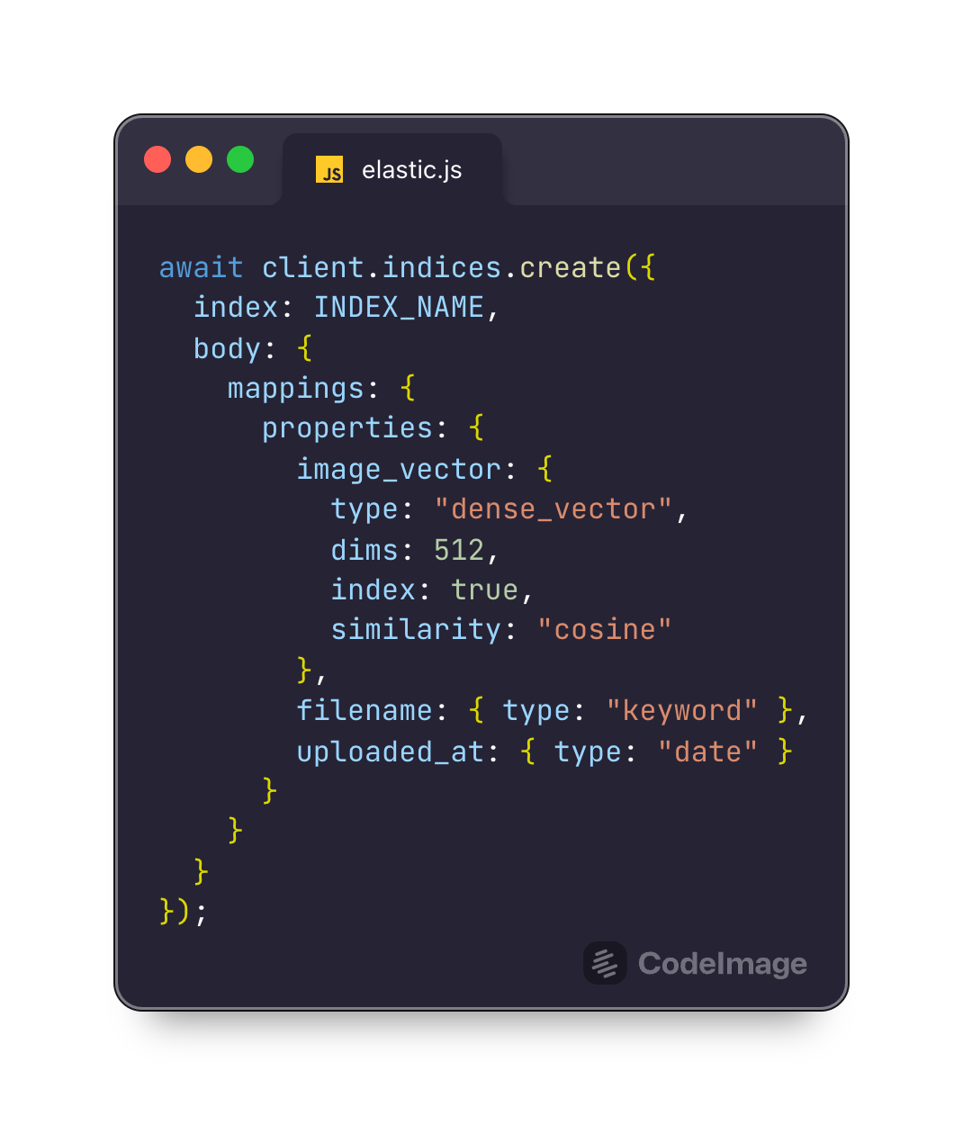

Slide 12
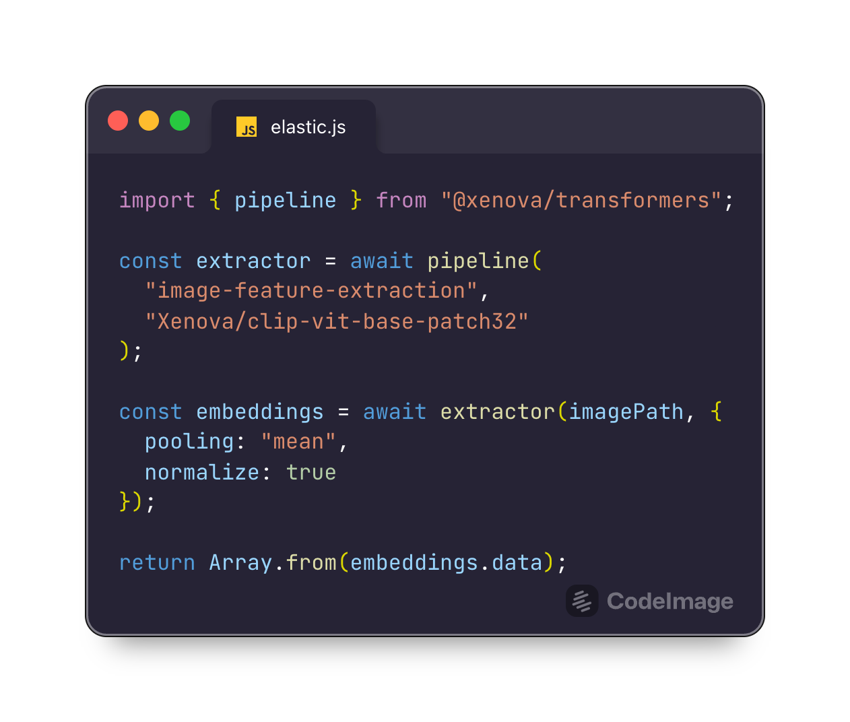

Slide 13
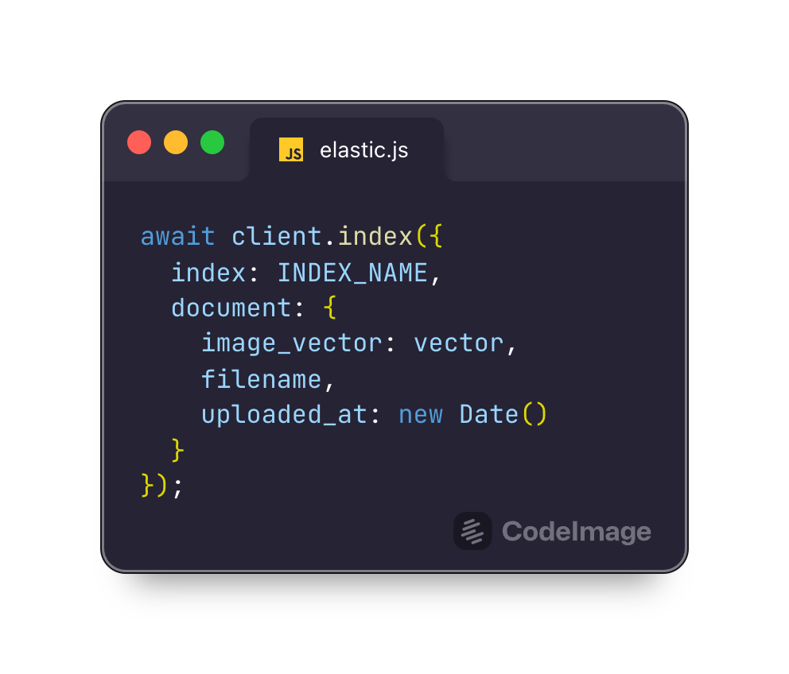

Slide 14
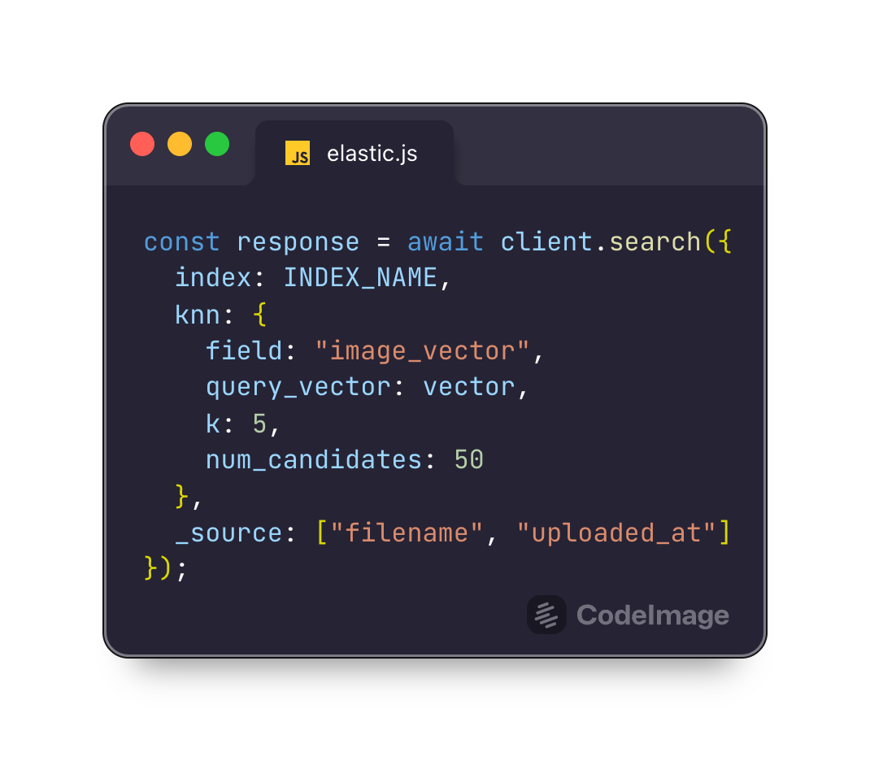

Slide 15
Elasticsearch Plugin for Nearest Neighbor Search
The knn search option accepts a number of parameters that configure the search:
field: the field in the index to search. The field must have a dense_vector type.
query_vector: the embedding to search for. This should be an embedding generated from the search text.
num_candidates: the number of candidate documents to consider from each shard. Elasticsearch retrieves this many candidates from each shard, combines them into a single list and then finds the closest "k" to return as results.
k: the number of results to return. This number has a direct effect on performance, so it should be kept as small as possible. The value passed in this option must be less than num_candidates.

Slide 16
Resources
Dense vector field type | Elasticsearch Guide [8.17] | Elastic
k-nearest neighbor (kNN) search | Elasticsearch Guide [8.17] | Elastic
Knn query | Elasticsearch Guide [8.17] | Elastic
https://www.elastic.co/search-labs/blog/implementing-image-search-with-elasticsearch
https://huggingface.co/Xenova/clip-vit-base-patch32
https://alexklibisz.github.io/elastiknn

Slide 17
Questions?

Slide 18

Thank You
More about me

